Slide 1
Mapping Earthquakes Around the World: A Geospatial Analysis
Aadhar Bansal
Masters of Science
Robotics (Computer Science)
bansal.aad@northestern.edu

Slide 2
Problem and Motivation
Earthquakes can have devastating effects on people and infrastructure, making tracking essential.
Accurate location data is needed to identify seismic trends and prepare for disasters.
Associating earthquakes with countries enables a comprehensive understanding of global seismic activity.
Disaster responses could be improved by identifying regions prone to earthquakes through mapping.
The ultimate goal is to reduce the impact of earthquakes and improve disaster preparedness worldwide.

Slide 3
Data source and background.
The earthquake data was sourced from the US Geological Survey and includes information on time, location, magnitude, and place.
The code uses the requests and pandas libraries to fetch, store, and manipulate the data.
The custom.geojson file was generated from https://geojson-maps.ash.ms/ and contains geographic information for the world's countries.
GeoJSON is a format for encoding geographic data structures that is based on the JSON format.

Slide 4
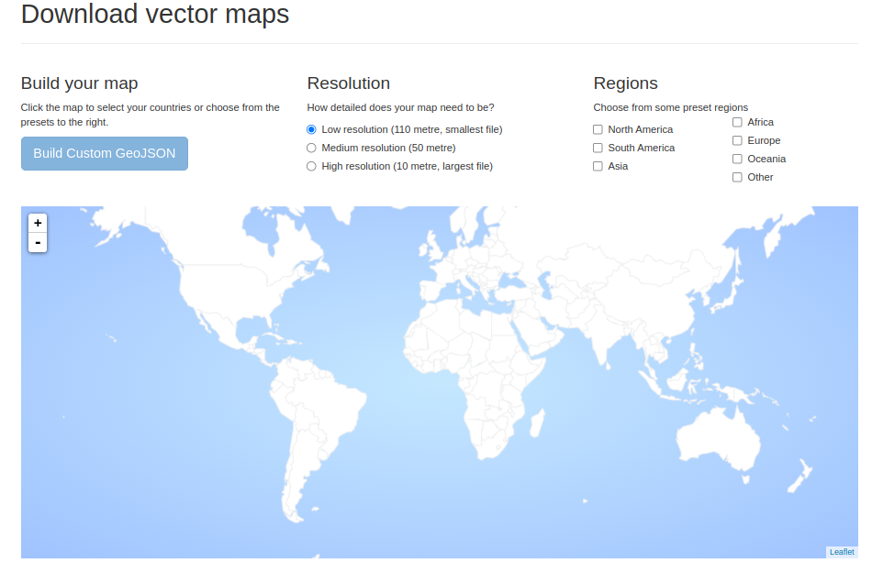

Slide 5
Data Mapping
Analysis of earthquake data from 2000 to 2022, with a minimum magnitude of 4.5.
Collection of data from the USGS earthquake data API with Python requests library.
Processing of data using Pandas DataFrame for easy manipulation and analysis.
Visualization of earthquake data on an interactive map with markers that provide magnitude and location information.
Geospatial analysis to link earthquakes to countries, enabling comprehensive seismic activity study.

Slide 6
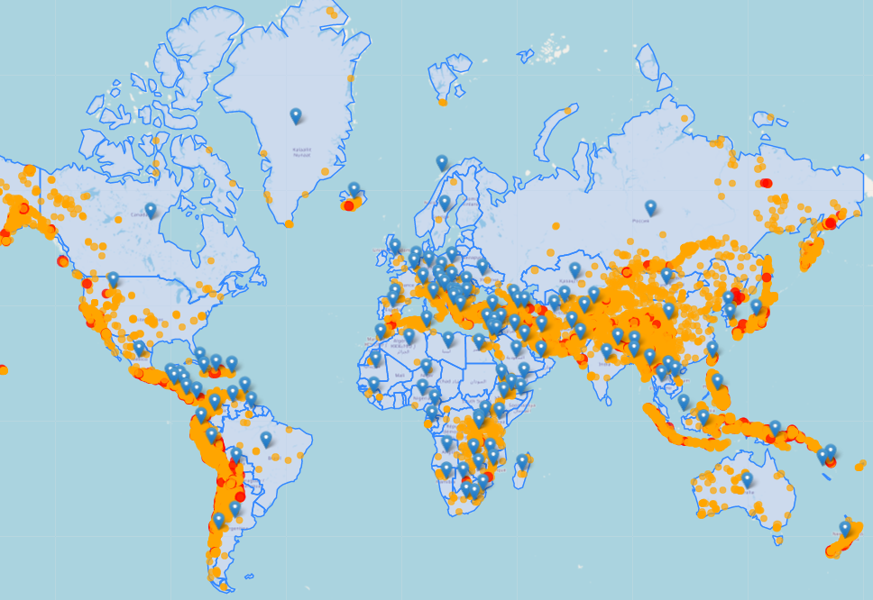
Methodology
Each earthquake's location linked to the corresponding country using geospatial analysis.
Earthquake data grouped by country, and trends analyzed using yearly counts.
Country centroids obtained to place markers on the map, showing country-level earthquake data.
Earthquake data visualized on an interactive map with country-level trends displayed on marker popups.

Slide 7
Tools
The code uses Python programming language to fetch earthquake data from USGS website.
Pandas library is used for data manipulation and analysis, while Matplotlib and Seaborn are used for data visualization.
Requests library is used for making HTTP requests to USGS website to fetch data.
Folium library is used for visualizing data on an interactive map.
GeoPandas library is used to process geojson data for country centroid calculation

Slide 8
Novelty
This provides a comprehensive analysis of global earthquake data over the last 22 years.
The use of geospatial data analysis techniques allows for the identification of earthquake patterns and trends over time.
The incorporation of earthquake magnitude and location data enhances the understanding of earthquake risk and impact.
The use of interactive maps and data visualizations facilitates the exploration and interpretation of earthquake data.
The inclusion of earthquake trend analysis by country allows for a deeper understanding of earthquake activity at a regional level.

Slide 9
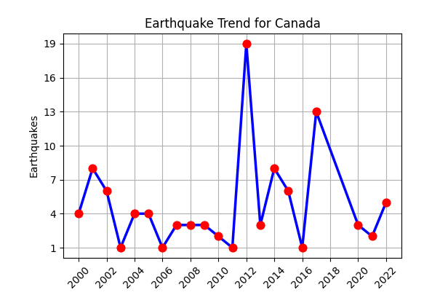
Visualization
Map markers with circle size proportional to magnitude provide clear and intuitive representation.
Different color-coded magnitudes in the legend make it easy to interpret the data.
Trend analysis plot for each country provides an insight into their earthquake activity over time.
Customized legend with easy-to-understand color codes and circle sizes makes data interpretation simple.
Popup trend analysis plot offers interactive and detailed insights about earthquake trends in each country.
Combined visualization of the data on the map and the trend analysis helps to analyze the data in a more integrated way.

Slide 10
Future works
Incorporate additional data sources, such as seismometer recordings, to enhance the accuracy and granularity of earthquake data.
Develop a real-time monitoring and alert system for seismic activity in high-risk areas.
Explore the use of machine learning algorithms for predicting earthquake occurrence and magnitude.

Slide 11
References
USGS Earthquake Hazards Program. (2021). Earthquake Catalog. Retrieved from https://earthquake.usgs.gov/earthquakes/search/
Folium. (n.d.). Python Data, Leaflet.js Maps. Retrieved from https://python-visualization.github.io/folium/
Pandas. (n.d.). Pandas Documentation. Retrieved from https://pandas.pydata.org/docs/
Seaborn. (n.d.). Seaborn: Statistical Data Visualization. Retrieved from https://seaborn.pydata.org/index.html
Matplotlib. (n.d.). Matplotlib: Visualization with Python. Retrieved from https://matplotlib.org/stable/index.html

Slide 12
Thank You

